Slide 1
Tower of Hanoi
Recursion in Python
COPYRIGHT: KUILIANG ZHANG ©

Slide 2
Introduction to Hanoi game
Rules
Only one disk can be moved at a time.
Each move consists of taking the upper disk from one of the stacks and placing it on top of another stack or on an empty rod.
No larger disk may be placed on top of a smaller disk.
1
A
B
C
2
A
B
C
COPYRIGHT: KUILIANG ZHANG ©

Slide 3
Solution
4
A
B
B
A
C
C
1
5
A
B
C
A
B
C
2
7
A
B
C
A
B
C
3
8
A
B
C
A
B
C
COPYRIGHT: KUILIANG ZHANG ©

Slide 4
intuition
1
A
B
C
2
A
B
C
3
A
B
C
COPYRIGHT: KUILIANG ZHANG ©

Slide 5
intuition
4
A
B
C
1
5
A
B
C
A
B
C
2
7
A
B
C
A
B
C
3
8
A
B
C
A
B
C
COPYRIGHT: KUILIANG ZHANG ©

Slide 6
intuition
1
A
B
C
1
2
A
B
C
A
B
B
A
C
C
2
3
A
B
C
A
B
B
A
C
C
3
4
A
B
C
A
B
B
A
C
C
COPYRIGHT: KUILIANG ZHANG ©

Slide 7
N=2 ← n=1
N=2
N=1
A
B
C
A
B
C
A
B
C
A
B
C
A
B
C
COPYRIGHT: KUILIANG ZHANG ©

Slide 8
N=2 ← n=1
N=2
N=1
A
B
C
A
B
C
A
B
C
A
B
C
A
B
C
COPYRIGHT: KUILIANG ZHANG ©

Slide 9
N=2 ← n=1
N=2
N=1
A
B
C
A
B
C
A
B
C
A
B
C
A
B
C
COPYRIGHT: KUILIANG ZHANG ©

Slide 10
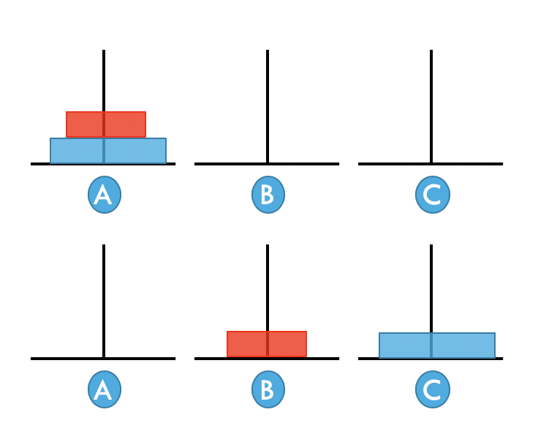
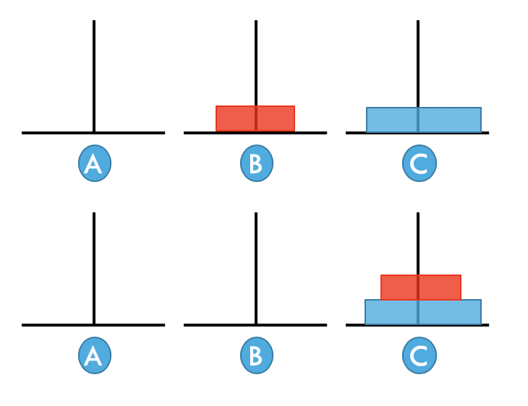
N=2 ← n=1
1. F(1, a, c, b)
If n = 2
2. Move the 2nd disk from a to c
F(n, a, b, c) =
3. F(1, b, a, c)
n disks
The start stack
The useless stack
If n = 1, then move disk from a to c
The end stack
COPYRIGHT: KUILIANG ZHANG ©

Slide 11
intuition
1
A
B
C
1
2
A
B
C
A
B
B
A
C
C
2
3
A
B
C
A
B
B
A
C
C
3
4
A
B
C
A
B
B
A
C
C
COPYRIGHT: KUILIANG ZHANG ©

Slide 12
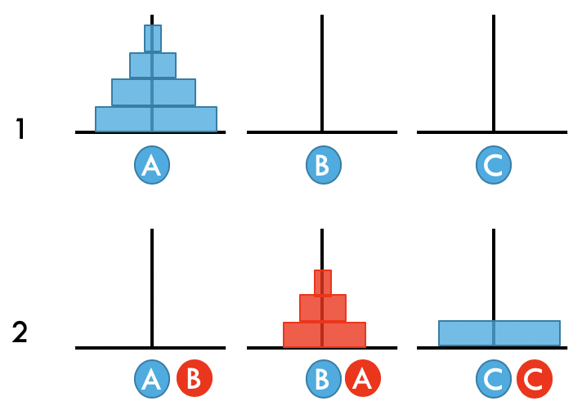
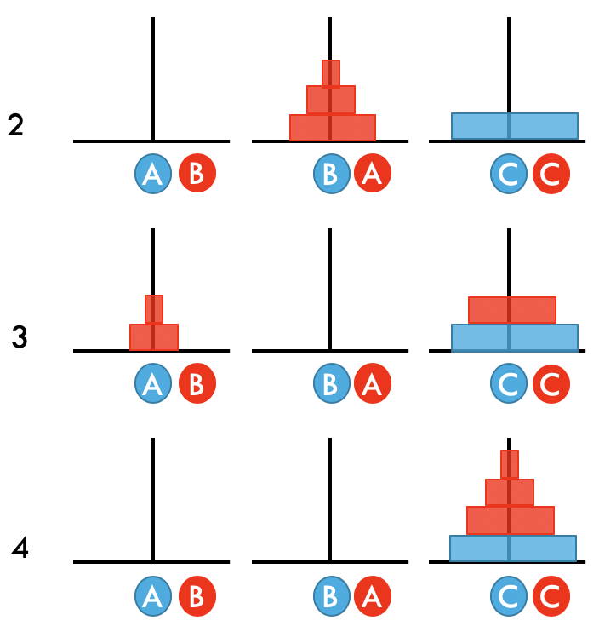
N=? ← n=1
1. F(n - 1, a, c, b)
Move n – 1 disks from a to b
If n > 1
2. Move the biggest disk from a to c
F(n, a, b, c) =
3. F(n - 1, b, a, c)
Move n – 1 disks from b to c
n disks
The start stack
The useless stack
If n = 1, then move disk from a to c
The end stack
COPYRIGHT: KUILIANG ZHANG ©

Slide 13
template
4
A
B
C
1
5
A
B
C
A
B
C
2
7
A
B
C
A
B
C
3
8
A
B
C
A
B
C
COPYRIGHT: KUILIANG ZHANG ©

